Slide 1
ISCG6423
Database Design and Development
Case Study C:
Assignment Information
This information may contain ambiguities and/or errors, and may be subject to change – please seek advice from the lecturer if necessary.

Slide 2
Numbers of Records
Client: 1,000 – will increase often
  Each Client has an average of 4 orders on the system at any one time
  Each client order, on average, consists of 3 books
  Each client has, on average, 2 preferred categories
Book Info: 4,000 – will increase often
  On average, there are three individual books of the same title
Author: 1000 – will increase but not often
  On average each author will have 4 book titles

Slide 3
Numbers of Records
Vendor: 100 – may increase
  Each vendor offers, on average, 120 books
  Each individual book will belong to one category on average
  60% of vendors have contact details
Category: 40 – very unlikely to change
  Each Category is preferred by, on average, 50 clients
  On average there are 300 individual books of each category
Country: 50 – may increase
  Each country has 20 clients on average
  Each country has 2 vendors on average

Slide 4
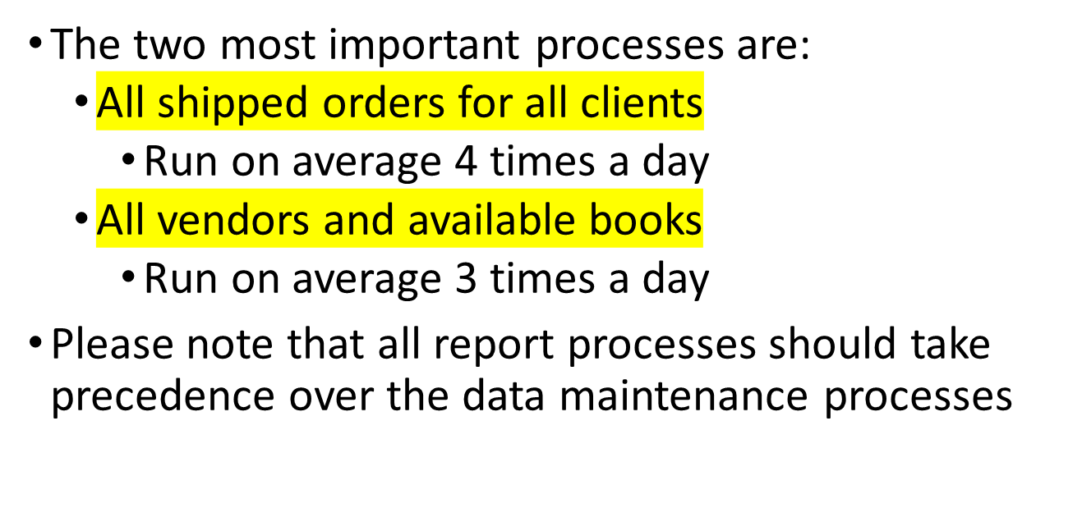
Important Processes

Slide 5
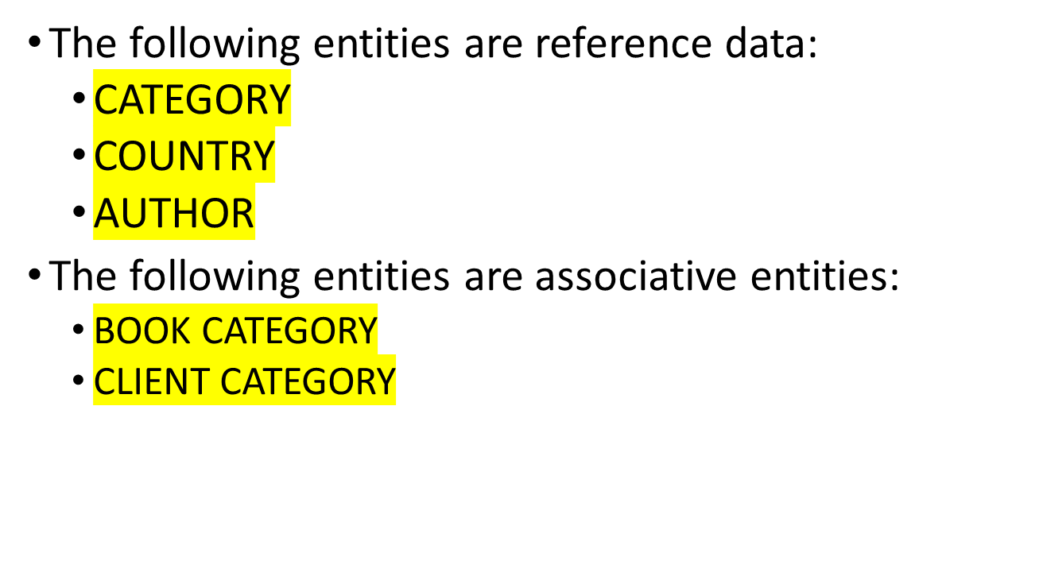
Notes on Logical Design

Slide 6
Look-up Data
CLIENT ORDER
  Status
    P - Paid
    C - Current
    S - Shipped
CLIENT
  Credit Status
    Good
    Bad
CLIENT CATEGORY
  CC_Level
    High
    Low
BOOK
  Available
    Y - Yes
    N - No

Slide 7
Book Brokers Conceptual ERD
CATEGORY
CLIENT
VENDOR
CLIENT
ORDER
BOOK
COUNTRY
CONTACT
BOOK
INFO
AUTHOR

Slide 8
Book Brokers Logical ERD
12,000
(300)
40
(50)
2,000
(2)
1,000
BOOK
CATEGORY
CLIENT
CATEGORY
CATEGORY
CLIENT
(1)
(20)
(4)
100
(120)
12,000
(3)
4,000
50
VENDOR
CLIENT
ORDER
BOOK
COUNTRY
(2)
(3)
(60%)
60
4,000
(4)
1,000
CONTACT
BOOK
INFO
AUTHOR

Slide 9
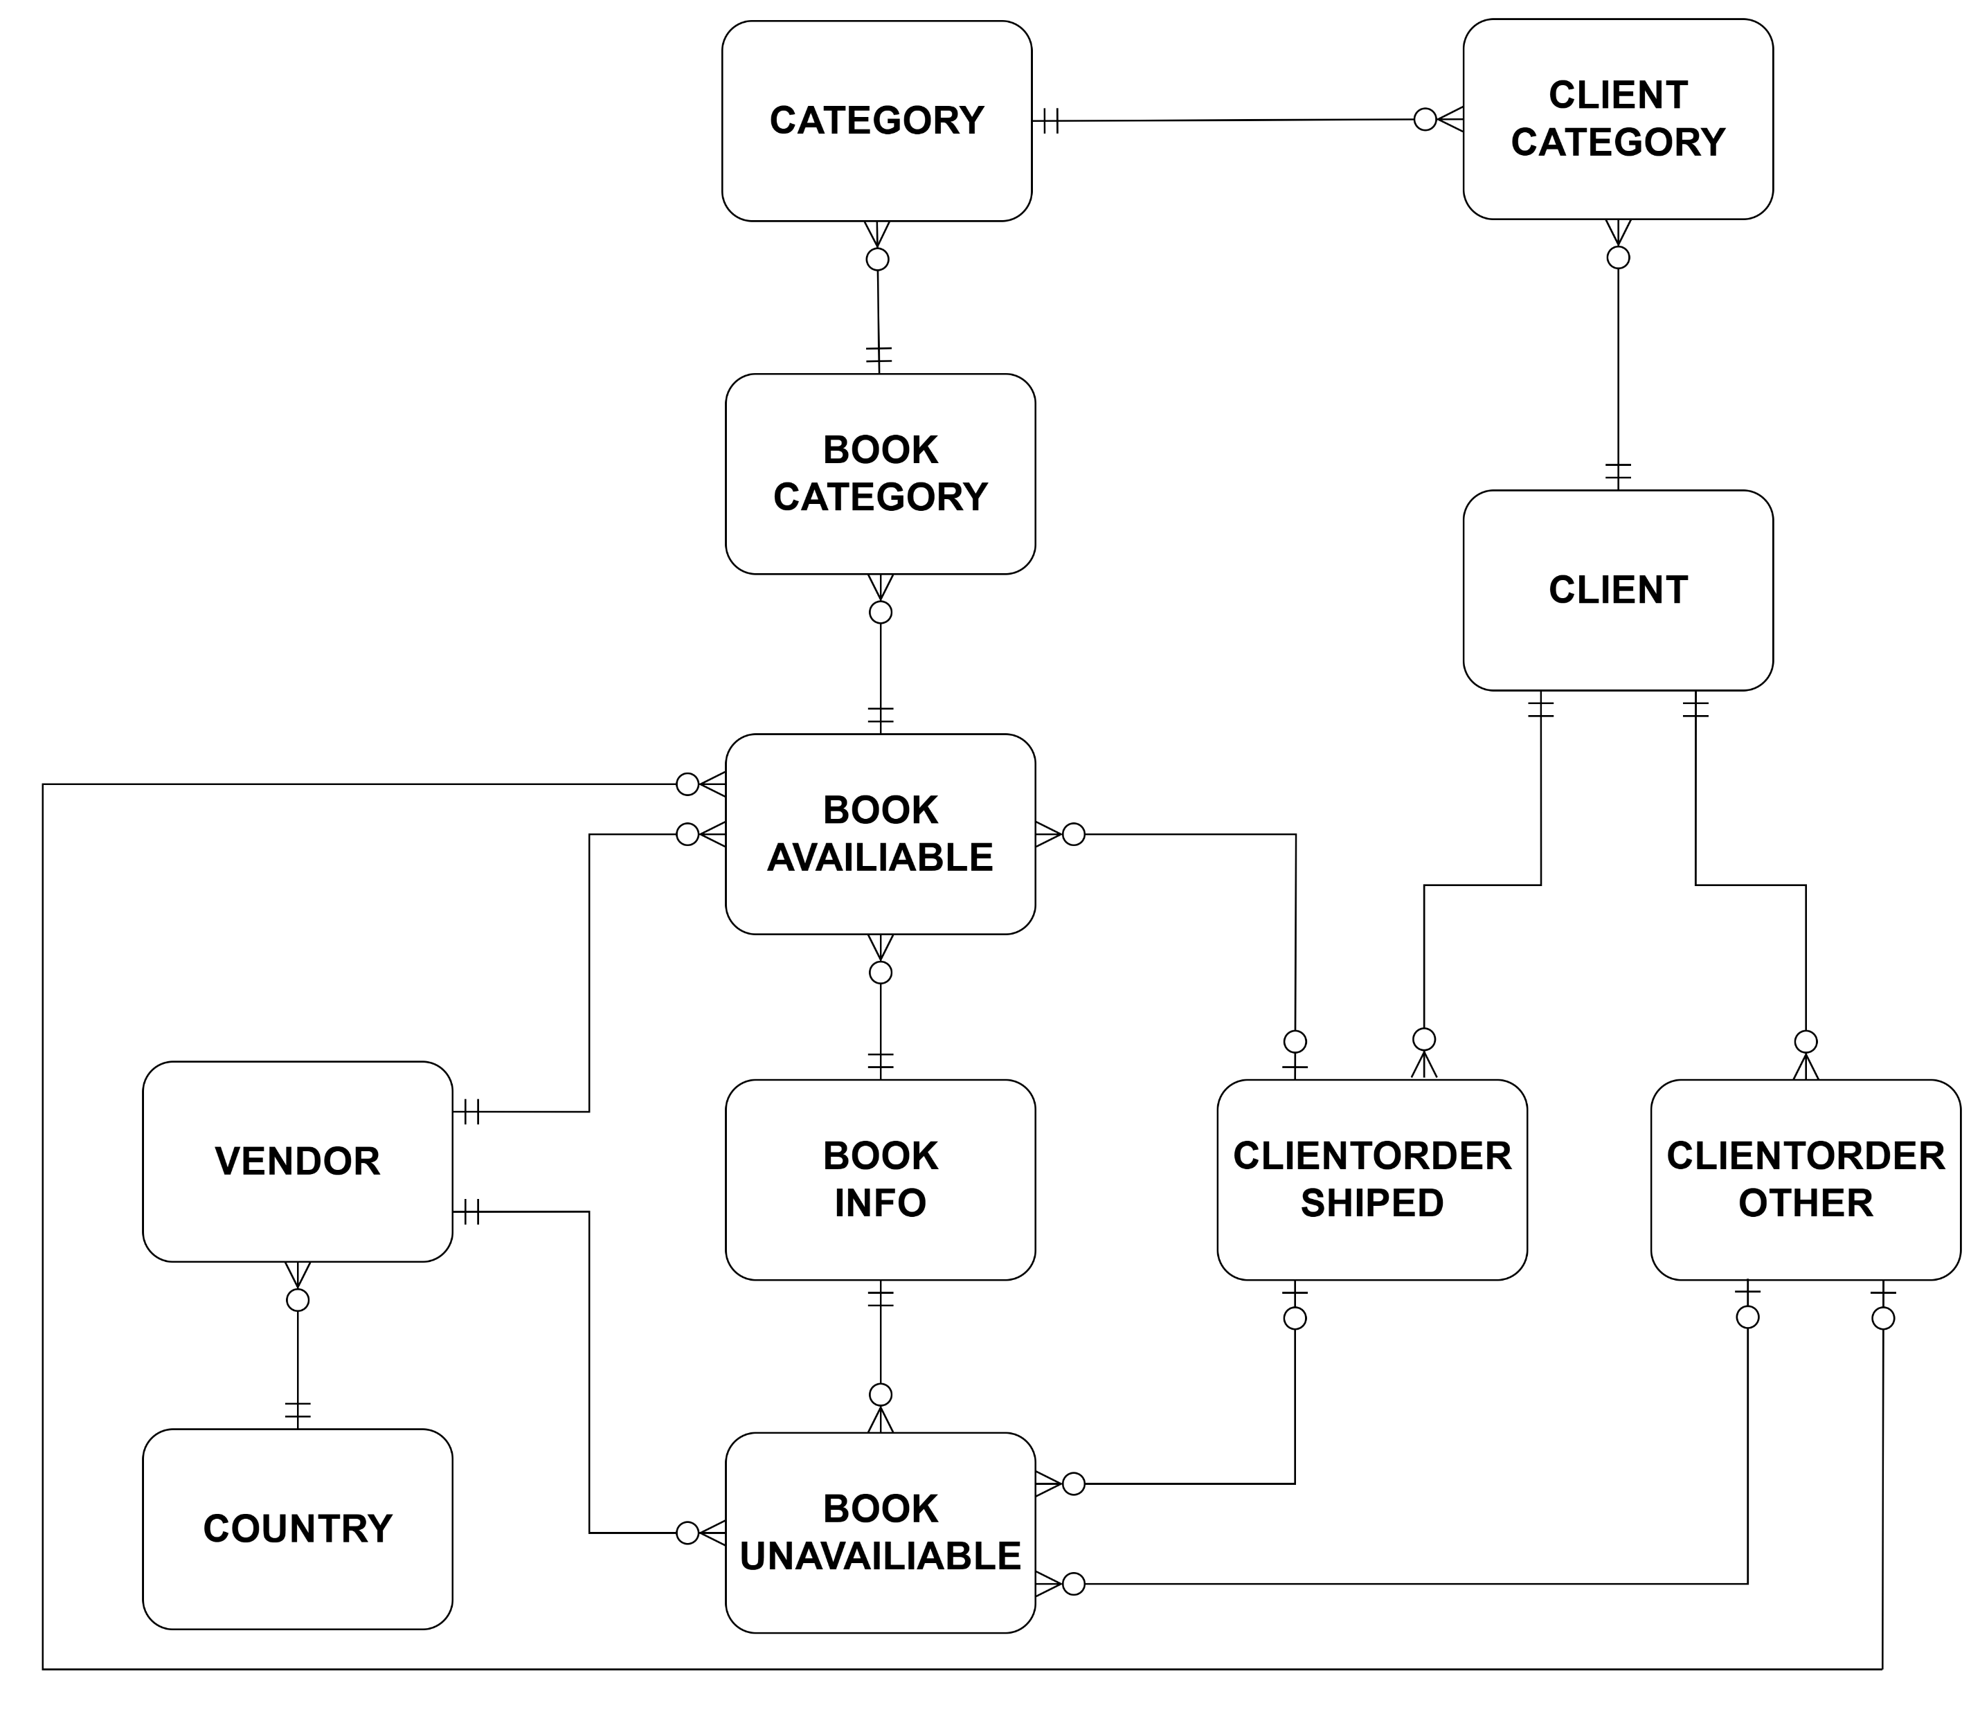
Book Brokers physical ERD

Slide 10
Book Brokers Application Relations
COUNTRY (CountryID, CountryName)
CATEGORY (CategoryID, Description)
CLIENT (ClientID, LastName, FirstName, StreetAddress, Suburb, City,
CountryID*, CreditStatus, PhoneNumber)
CLIENTORDER (ClientOrderID, OrderDate, ClientID*, Status)
AUTHOR (AuthorID, LastName, FirstName)
VENDOR (VendorID, VendorName, CountryID*, Email)
BOOKINFO (BookInfoID, Title, AuthorID*, Notes)
BOOK (BookID, Cost, Price, Available, DatePublished,
BookInfoID*, VendorID*, ClientOrderID*)
BOOKCATEGORY (BookID*, CategoryID*)
CLIENTCATEGORY (ClientID*, CategoryID*, CC_Level)
CONTACT (VendorID*, LastName, FirstName, Email)

Slide 11
1) Enter, modify or delete Clients
CLIENT
CATEGORY
CLIENT
CLIENT
ORDER
COUNTRY
COUNTRY (CountryID, CountryName)
CLIENT (ClientID, LastName, FirstName, StreetAddress, Suburb, City,
CountryID*, CreditStatus, PhoneNumber)
CLIENTORDER (ClientOrderID, OrderDate, ClientID*, Status)
CLIENTCATEGORY (ClientID*, CategoryID*, CC_Level)

Slide 12
2) Enter, modify or delete Vendors
COUNTRY
VENDOR
BOOK
CONTACT
COUNTRY (CountryID, CountryName)
VENDOR (VendorID, VendorName, CountryID*, Email)
BOOK (BookID, Cost, Price, Available, DatePublished,
BookInfoID*, VendorID*, ClientOrderID*)
CONTACT (VendorID*, LastName, FirstName, Email)

Slide 13
3) Enter, modify or delete Books
BOOK
CATEGORY
VENDOR
BOOK
BOOK
INFO
AUTHOR
AUTHOR (AuthorID, LastName, FirstName)
VENDOR (VendorID, VendorName, CountryID*, Email)
BOOKINFO (BookInfoID, Title, AuthorID*, Notes)
BOOK (BookID, Cost, Price, Available, DatePublished,
BookInfoID*, VendorID*, ClientOrderID*)
BOOKCATEGORY (BookID*, CategoryID*)

Slide 14
4) Enter, modify or delete Clients’ Book Orders
VENDOR
CLIENT
ORDER
CLIENT
BOOK
BOOK
INFO
COUNTRY
COUNTRY (CountryID, CountryName)
CLIENT (ClientID, LastName, FirstName, StreetAddress, Suburb, City,
CountryID*, CreditStatus, PhoneNumber)
CLIENTORDER (ClientOrderID, OrderDate, ClientID*, Status)
VENDOR (VendorID, VendorName, CountryID*, Email)
BOOKINFO (BookInfoID, Title, AuthorID*, Notes)
BOOK (BookID, Cost, Price, Available, DatePublished,
BookInfoID*, VendorID*, ClientOrderID*)

Slide 15
5) Add or remove Categories to or from Books and Clients
BOOK
CATEGORY
CLIENT
CATEGORY
CATEGORY
CLIENT
BOOK
INFO
AUTHOR
BOOK
CATEGORY (CategoryID, Description)
CLIENT (ClientID, LastName, FirstName, StreetAddress, Suburb, City,
CountryID*, CreditStatus, PhoneNumber)
AUTHOR (AuthorID, LastName, FirstName)
BOOKINFO (BookInfoID, Title, AuthorID*, Notes)
BOOK (BookID, Cost, Price, Available, DatePublished,
BookInfoID*, VendorID*, ClientOrderID*)
CLIENTCATEGORY (ClientID*, CategoryID*, CC_Level)
BOOKCATEGORY (BookID*, CategoryID*)

Slide 16
6) Mark a Client Order as shipped or paid
CLIENT
CLIENT
ORDER
BOOK
CLIENT (ClientID, LastName, FirstName, StreetAddress, Suburb, City,
CountryID*, CreditStatus, PhoneNumber)
CLIENTORDER (ClientOrderID, OrderDate, ClientID*, Status)
BOOK (BookID, Cost, Price, Available, DatePublished,
BookInfoID*, VendorID*, ClientOrderID*)

Slide 17
7) All Vendors and unavailable Books
VENDOR
BOOK
CONTACT
BOOK
INFO
AUTHOR
AUTHOR (AuthorID, LastName, FirstName)
VENDOR (VendorID, VendorName, CountryID*, Email)
BOOKINFO (BookInfoID, Title, AuthorID*, Notes)
BOOK (BookID, Cost, Price, Available, DatePublished,
BookInfoID*, VendorID*, ClientOrderID*)
CONTACT (VendorID*, LastName, FirstName, Email)

Slide 18
8) All Vendors and available Books
100
3
VENDOR
BOOK
(120)
36,000
(60%)
180
36,000
36,000
CONTACT
BOOK
INFO
AUTHOR
AUTHOR (AuthorID, LastName, FirstName)
VENDOR (VendorID, VendorName, CountryID*, Email)
BOOKINFO (BookInfoID, Title, AuthorID*, Notes)
BOOK (BookID, Cost, Price, Available, DatePublished,
BookInfoID*, VendorID*, ClientOrderID*)
CONTACT (VendorID*, LastName, FirstName, Email)

Slide 19
9) All shipped Orders for all Clients
4
1,000
BOOK
INFO
CLIENT
48,000
16,000
(4)
4,000
48,000
48,000
(3)
CLIENT
ORDER
VENDOR
COUNTRY
BOOK
COUNTRY (CountryID, CountryName)
CLIENT (ClientID, LastName, FirstName, StreetAddress, Suburb, City,
CountryID*, CreditStatus, PhoneNumber)
CLIENTORDER (ClientOrderID, OrderDate, ClientID*, Status)
VENDOR (VendorID, VendorName, CountryID*, Email)
BOOKINFO (BookInfoID, Title, AuthorID*, Notes)
BOOK (BookID, Cost, Price, Available, DatePublished,
BookInfoID*, VendorID*, ClientOrderID*)

Slide 20
10) All clients
CLIENT
CATEGORY
CATEGORY
CLIENT
COUNTRY
COUNTRY (CountryID, CountryName)
CATEGORY (CategoryID, Description)
CLIENT (ClientID, LastName, FirstName, StreetAddress, Suburb, City,
CountryID*, CreditStatus, PhoneNumber)
CLIENTCATEGORY (ClientID*, CategoryID*, CC_Level)

Slide 21
11) Books by vendor
VENDOR
BOOK
BOOK
INFO
VENDOR (VendorID, VendorName, CountryID*, Email)
BOOKINFO (BookInfoID, Title, AuthorID*, Notes)
BOOK (BookID, Cost, Price, Available, DatePublished,
BookInfoID*, VendorID*, ClientOrderID*)

Slide 22
12) Books by client
CLIENT
CLIENT
ORDER
BOOK
CLIENT (ClientID, LastName, FirstName, StreetAddress, Suburb, City,
CountryID*, CreditStatus, PhoneNumber)
CLIENTORDER (ClientOrderID, OrderDate, ClientID*, Status)
BOOK (BookID, Cost, Price, Available, DatePublished,
BookInfoID*, VendorID*, ClientOrderID*)

Slide 23
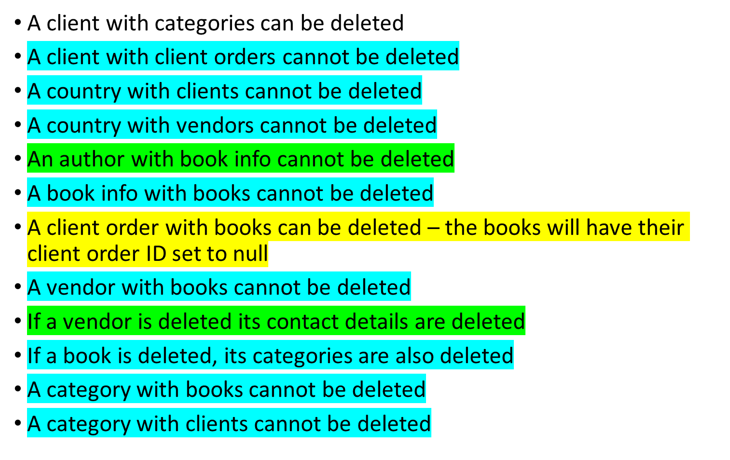
Referential Integrity Constraints
Please note that operational business rules can override these constraints

